Slide 1



Slide 2
Overview of Course
Topics include:
Introduction and exploratory analysis (Week 1)
Supervised machine learning (Weeks 2–10)
Unsupervised machine learning (Weeks 11–12)
10

Slide 3
Overview of Course
Topics include:
Introduction and exploratory analysis (Week 1)
Supervised machine learning (Weeks 2–10)
Unsupervised machine learning (Weeks 11–12)
Each week:
Lecture
Exercises with solutions
Time commitment: ~3 hours per week
10

Slide 4
Our Toolset: Intel® Distribution for Python
Accelerated performance from Intel's Math Kernel Library (MKL)
10

Slide 5
Our Toolset: Intel® Distribution for Python
Accelerated performance from Intel's Math Kernel Library (MKL)
Also contains Data Analytics Acceleration Library (DAAL), Message Passing Interface (MPI), and Threading Building Blocks (TBB)
10

Slide 6
Our Toolset: Intel® Distribution for Python
Accelerated performance from Intel's Math Kernel Library (MKL)
Also contains Data Analytics Acceleration Library (DAAL), Message Passing Interface (MPI), and Threading Building Blocks (TBB)
INSTALLATION OPTIONS
software.intel.com/
Monolithic Distribution
intel-distribution-for-python
Anaconda Package Manager
articles/using-intel-distribution-for-python-with-anaconda
10

Slide 7
Our Toolset: Intel® Distribution for Python
Accelerated performance from Intel's Math Kernel Library (MKL)
Also contains Data Analytics Acceleration Library (DAAL), Message Passing Interface (MPI), and Threading Building Blocks (TBB)
INSTALLATION OPTIONS
software.intel.com/
Monolithic Distribution
intel-distribution-for-python
Anaconda Package Manager
articles/using-intel-distribution-for-python-with-anaconda
Seaborn is also required: conda install seaborn
10

Slide 8
Our Toolset: Intel® Distribution for Python
Jupyter notebooks:
Interactive Coding and Visualization of Output
NumPy, SciPy, Pandas:
Numerical Computation
Matplotlib, Seaborn:
Data Visualization
Scikit-learn:
Machine Learning
10

Slide 9
Our Toolset: Intel® Distribution for Python
Jupyter notebooks:
Interactive Coding and Visualization of Output
NumPy, SciPy, Pandas:
Numerical Computation
Matplotlib, Seaborn:
Data Visualization
Week 1
Scikit-learn:
Machine Learning
10

Slide 10
Our Toolset: Intel® Distribution for Python
Jupyter notebooks:
Interactive Coding and Visualization of Output
NumPy, SciPy, Pandas:
Numerical Computation
Matplotlib, Seaborn:
Data Visualization
Scikit-learn:
Machine Learning
Weeks 2–12
10

Slide 11
Jupyter Notebook

Slide 12
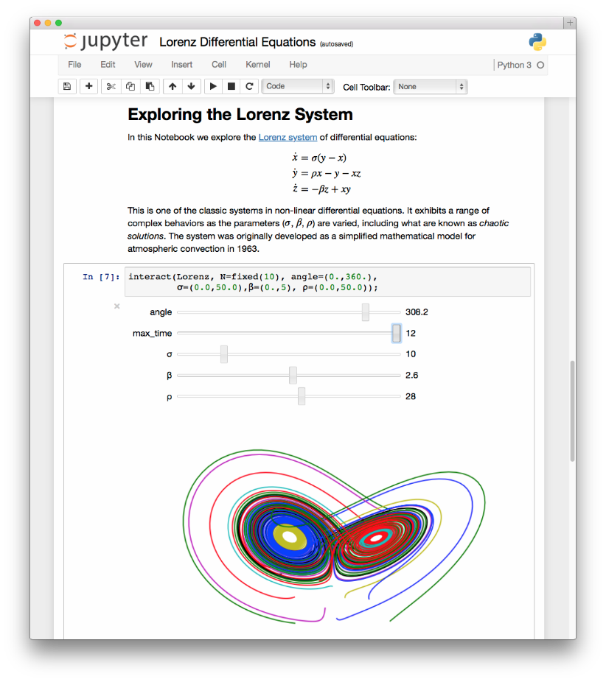
Introduction to Jupyter Notebook
Polyglot analysis environment—
blends multiple languages
Source: http://jupyter.org/

Slide 13
Introduction to Jupyter Notebook
Polyglot analysis environment—
blends multiple languages
Jupyter is an anagram of: Julia, Python, and R
Source: http://jupyter.org/

Slide 14
Introduction to Jupyter Notebook
Polyglot analysis environment—
blends multiple languages
Jupyter is an anagram of: Julia, Python, and R
Supports multiple content types: code, narrative text, images, movies, etc.
Source: http://jupyter.org/

Slide 15
Introduction to Jupyter Notebook
HTML & Markdown
LaTeX (equations)
Code
Source: http://jupyter.org/

Slide 16
Introduction to Jupyter Notebook
HTML & Markdown
LaTeX (equations)
Code
Source: http://jupyter.org/

Slide 17
Introduction to Jupyter Notebook
HTML & Markdown
LaTeX (equations)
Code
Source: http://jupyter.org/

Slide 18

Introduction to Jupyter Notebook
HTML & Markdown
LaTeX (equations)
Code
Source: http://jupyter.org/

Slide 19

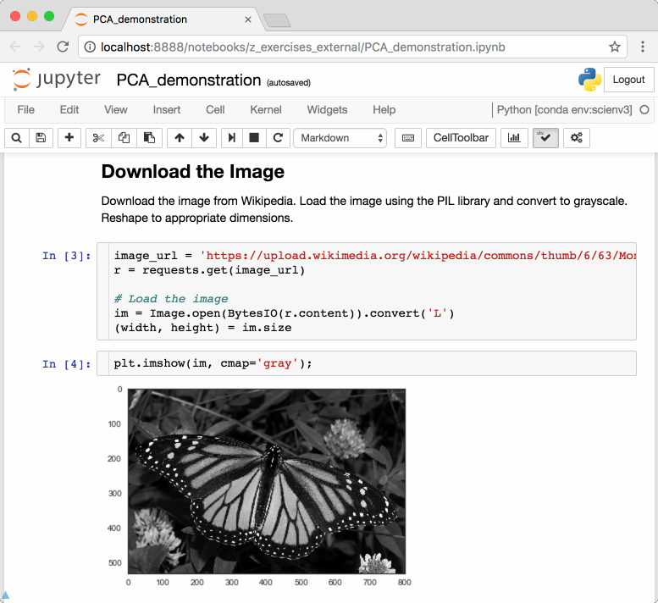
Introduction to Jupyter Notebook
Code is divided into cells to
control execution
Enables interactive development
Ideal for exploratory analysis and model building

Slide 20
Introduction to Jupyter Notebook
Code is divided into cells to
control execution
Enables interactive development
Ideal for exploratory analysis and model building

Slide 21

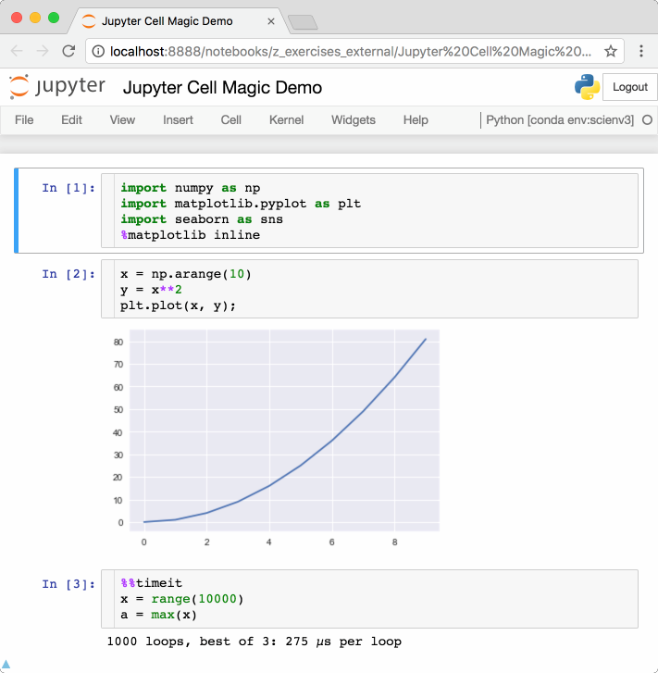
Jupyter Cell Magics
%matplotlib inline: display plots
inline in Jupyter notebook

Slide 22
Jupyter Cell Magics
%matplotlib inline: display plots
inline in Jupyter notebook

Slide 23
Jupyter Cell Magics
%matplotlib inline: display plots
inline in Jupyter notebook

Slide 24
Jupyter Cell Magics
%matplotlib inline: display plots
inline in Jupyter notebook
%%timeit: time how long a cell takes to execute

Slide 25

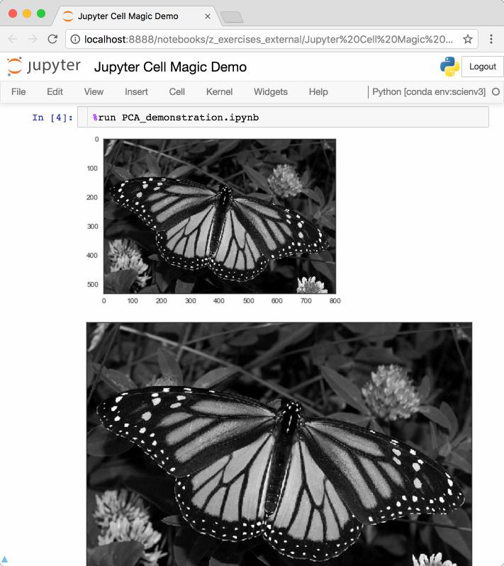
Jupyter Cell Magics
%matplotlib inline: display plots
inline in Jupyter notebook
%%timeit: time how long a cell takes to execute
%run filename.ipynb: execute code from another notebook or python file

Slide 26
Jupyter Cell Magics
%matplotlib inline: display plots
inline in Jupyter notebook
%%timeit: time how long a cell takes to execute
%run filename.ipynb: execute code from another notebook or python file
%load filename.py: copy contents
of the file and paste into the cell

Slide 27

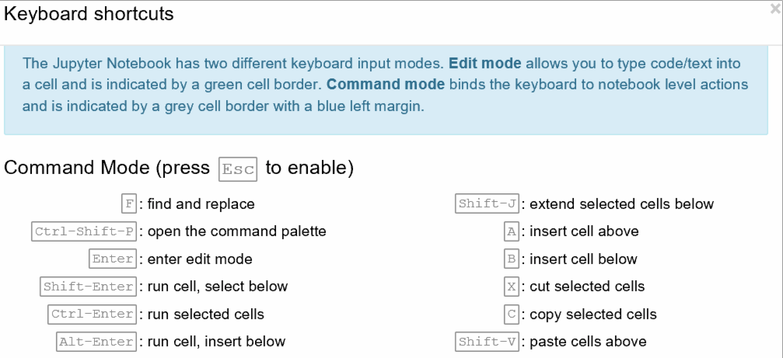
Jupyter Keyboard Shortcuts
Keyboard shortcuts can be viewed from Help → Keyboard Shortcuts

Slide 28
Making Jupyter Notebooks Reusable
To extract Python code from a Jupyter notebook:
Convert from Command Line
>>> jupyter nbconvert --to python
notebook.ipynb

Slide 29

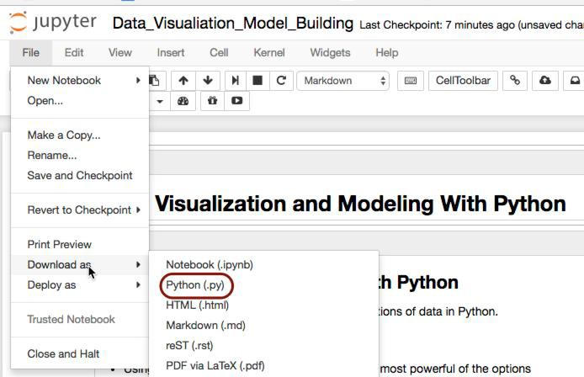
Making Jupyter Notebooks Reusable
To extract Python code from a Jupyter notebook:
Convert from Command Line
>>> jupyter nbconvert --to python
notebook.ipynb
Export from Notebook

Slide 30
pandas

Slide 31
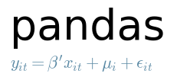

Introduction to Pandas
Library for computation with tabular
data
Mixed types of data allowed in a single table
Columns and rows of data can be named
Advanced data aggregation and statistical functions
Source: http://pandas.pydata.org/

Slide 32
Introduction to Pandas
Basic data structures
Type
Pandas Name
Vector
(1 Dimension)
Series

Slide 33
Introduction to Pandas
Basic data structures
Type
Pandas Name
Vector
(1 Dimension)
Array
(2 Dimensions)
Series
DataFrame

Slide 34
Pandas Series Creation and Indexing
Use data from step tracking application to create a Pandas Series
CODE
OUTPUT
import pandas as pd
step_data = [3620, 7891, 9761,
3907, 4338, 5373]
step_counts = pd.Series(step_data,
name='steps')
print(step_counts)

Slide 35
Pandas Series Creation and Indexing
Use data from step tracking application to create a Pandas Series
CODE
OUTPUT
>>> | 0 3620
 | 1 7891
 | 2 9761
 | 3 3907
 | 4 4338
 | 5 5373
 | Name: steps, dtype: int64
import pandas as pd
step_data = [3620, 7891, 9761,
3907, 4338, 5373]
step_counts = pd.Series(step_data,
name='steps')
print(step_counts)

Slide 36
Pandas Series Creation and Indexing
Add a date range to the Series
CODE
OUTPUT
step_counts.index = pd.date_range('20150329’,
periods=6)
print(step_counts)

Slide 37
Pandas Series Creation and Indexing
Add a date range to the Series
CODE
OUTPUT
>>> | 2015-03-29 3620
 | 2015-03-30 7891
 | 2015-03-31 9761
 | 2015-04-01 3907
 | 2015-04-02 4338
 | 2015-04-03 5373
 | Freq: D, Name: steps,
 | dtype: int64
step_counts.index = pd.date_range('20150329’,
periods=6)
print(step_counts)

Slide 38
Pandas Series Creation and Indexing
Select data by the index values
CODE
OUTPUT
# Just like a dictionary
print(step_counts['2015-04-01'])

Slide 39
Pandas Series Creation and Indexing
Select data by the index values
CODE
OUTPUT
# Just like a dictionary
print(step_counts['2015-04-01'])
>>> 3907

Slide 40
Pandas Series Creation and Indexing
Select data by the index values
CODE
OUTPUT
# Just like a dictionary
print(step_counts['2015-04-01'])
# Or by index position—like an array
print(step_counts[3])
>>> 3907

Slide 41
Pandas Series Creation and Indexing
Select data by the index values
CODE
OUTPUT
# Just like a dictionary
print(step_counts['2015-04-01'])
# Or by index position—like an array
print(step_counts[3])
>>> 3907
>>> 3907

Slide 42
Pandas Series Creation and Indexing
Select data by the index values
CODE
# Just like a dictionary
print(step_counts['2015-04-01'])
# Or by index position—like an array
print(step_counts[3])
# Select all of April
print(step_counts['2015-04'])
OUTPUT
>>> 3907
>>> 3907

Slide 43
Pandas Series Creation and Indexing
Select data by the index values
CODE |  | OUTPUT
# Just like a dictionary
print(step_counts['2015-04-01']) |  | >>> 3907
# Or by index position—like an array
print(step_counts[3]) |  | >>> 3907
# Select all of April
print(step_counts['2015-04']) |  | >>> 2015-04-01 | 3907
 |  | 2015-04-02 | 4338
 |  | 2015-04-03 5373 Freq: D, Name: steps, dtype: int64

Slide 44
Pandas Data Types and Imputation
Data types can be viewed and converted
CODE
OUTPUT
# View the data type
print(step_counts.dtypes)

Slide 45
Pandas Data Types and Imputation
Data types can be viewed and converted
CODE
OUTPUT
# View the data type
print(step_counts.dtypes)
>>> int64

Slide 46
Pandas Data Types and Imputation
Data types can be viewed and converted
CODE
OUTPUT
# View the data type
print(step_counts.dtypes)
# Convert to a float
step_counts = step_counts.astype(np.float)
# View the data type
print(step_counts.dtypes)
>>> int64

Slide 47
Pandas Data Types and Imputation
Data types can be viewed and converted
CODE
OUTPUT
# View the data type
print(step_counts.dtypes)
# Convert to a float
step_counts = step_counts.astype(np.float)
# View the data type
print(step_counts.dtypes)
>>> int64
>>> float64

Slide 48
Pandas Data Types and Imputation
Invalid data points can be easily filled with values
CODE
# Create invalid data
step_counts[1:3] = np.NaN
# Now fill it in with zeros
step_counts = step_counts.fillna(0.)
# equivalently,
# step_counts.fillna(0., inplace=True)
print(step_counts[1:3])
OUTPUT

Slide 49
Pandas Data Types and Imputation
Invalid data points can be easily filled with values
CODE
# Create invalid data
step_counts[1:3] = np.NaN
# Now fill it in with zeros
step_counts = step_counts.fillna(0.)
# equivalently,
# step_counts.fillna(0., inplace=True)
print(step_counts[1:3])
OUTPUT
>>> 2015-03-30 0.0
2015-03-31 0.0
Freq: D, Name: steps, dtype: float64

Slide 50
Pandas DataFrame Creation and Methods
DataFrames can be created from lists, dictionaries, and Pandas Series
CODE
# Cycling distance
cycling_data = [10.7, 0, None, 2.4, 15.3,
10.9, 0, None]
# Create a tuple of data
joined_data = list(zip(step_data,
cycling_data))
# The dataframe
activity_df = pd.DataFrame(joined_data)
print(activity_df)
OUTPUT

Slide 51
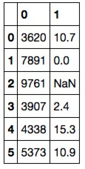
Pandas DataFrame Creation and Methods
DataFrames can be created from lists, dictionaries, and Pandas Series
CODE OUTPUT
# Cycling distance
cycling_data = [10.7, 0, None, 2.4, 15.3,
10.9, 0, None]
>>>
# Create a tuple of data
joined_data = list(zip(step_data,
cycling_data))
# The dataframe
activity_df = pd.DataFrame(joined_data)
print(activity_df)

Slide 52
Pandas DataFrame Creation and Methods
Labeled columns and an index can be added
CODE
OUTPUT
# Add column names to dataframe
activity_df = pd.DataFrame(joined_data,
index=pd.date_range('20150329’, periods=6), columns=['Walking','Cycling'])
print(activity_df)

Slide 53
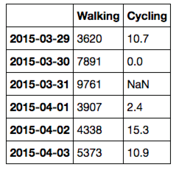
Pandas DataFrame Creation and Methods
Labeled columns and an index can be added
CODE
OUTPUT
# Add column names to dataframe
activity_df = pd.DataFrame(joined_data,
index=pd.date_range('20150329’, periods=6), columns=['Walking','Cycling'])
print(activity_df)
>>>

Slide 54
Indexing DataFrame Rows
DataFrame rows can be indexed by row using the 'loc' and 'iloc' methods
CODE
OUTPUT
# Select row of data by index name
print(activity_df.loc['2015-04-01'])

Slide 55
Indexing DataFrame Rows
DataFrame rows can be indexed by row using the 'loc' and 'iloc' methods
CODE |  | OUTPUT
# Select row of data by index name
print(activity_df.loc['2015-04-01']) |  | >>> Walking | 3907.0
 |  | Cycling 2.4 Name: 2015-04-01, dtype: float64

Slide 56
Indexing DataFrame Rows
DataFrame rows can be indexed by row using the 'loc' and 'iloc' methods
CODE
OUTPUT
# Select row of data by integer position
print(activity_df.iloc[-3])

Slide 57
Indexing DataFrame Rows
DataFrame rows can be indexed by row using the 'loc' and 'iloc' methods
CODE |  | OUTPUT
# Select row of data by integer position
print(activity_df.iloc[-3]) |  | >>> Walking | 3907.0
 |  | Cycling 2.4 Name: 2015-04-01, dtype: float64

Slide 58
Indexing DataFrame Columns
DataFrame columns can be indexed by name
CODE
OUTPUT
# Name of column
print(activity_df['Walking'])

Slide 59
Indexing DataFrame Columns
DataFrame columns can be indexed by name
CODE
OUTPUT
>>> | 2015-03-29 3620
 | 2015-03-30 7891
 | 2015-03-31 9761
 | 2015-04-01 3907
 | 2015-04-02 4338
 | 2015-04-03 5373
 | Freq: D, Name: Walking,
 | dtype: int64
# Name of column
print(activity_df['Walking'])

Slide 60
Indexing DataFrame Columns
DataFrame columns can also be indexed as properties
CODE
OUTPUT
# Object-oriented approach
print(activity_df.Walking)

Slide 61
Indexing DataFrame Columns
DataFrame columns can also be indexed as properties
CODE
OUTPUT
>>> | 2015-03-29 3620
 | 2015-03-30 7891
 | 2015-03-31 9761
 | 2015-04-01 3907
 | 2015-04-02 4338
 | 2015-04-03 5373
 | Freq: D, Name: Walking,
 | dtype: int64
# Object-oriented approach
print(activity_df.Walking)

Slide 62
Indexing DataFrame Columns
DataFrame columns can be indexed by integer
CODE
OUTPUT
# First column
print(activity_df.iloc[:,0])

Slide 63
Indexing DataFrame Columns
DataFrame columns can be indexed by integer
CODE
OUTPUT
>>> | 2015-03-29 3620
 | 2015-03-30 7891
 | 2015-03-31 9761
 | 2015-04-01 3907
 | 2015-04-02 4338
 | 2015-04-03 5373
 | Freq: D, Name: Walking,
 | dtype: int64
# First column
print(activity_df.iloc[:,0])

Slide 64
Reading Data with Pandas
CSV and other common filetypes can be read with a single command
CODE
OUTPUT
# The location of the data file
filepath = 'data/Iris_Data/Iris_Data.csv'
# Import the data
data = pd.read_csv(filepath)
# Print a few rows
print(data.iloc[:5])

Slide 65
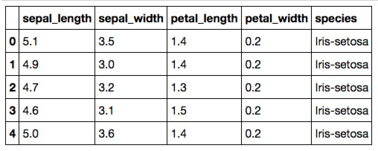
Reading Data with Pandas
CSV and other common filetypes can be read with a single command
CODE
OUTPUT
# The location of the data file
filepath = 'data/Iris_Data/Iris_Data.csv'
# Import the data
data = pd.read_csv(filepath)
# Print a few rows
print(data.iloc[:5])
>>>

Slide 66
Assigning New Data to a DataFrame
Data can be (re)assigned to a DataFrame column
CODE
# Create a new column that is a product
# of both measurements
data['sepal_area'] = data.sepal_length
*data.sepal_width
# Print a few rows and columns
print(data.iloc[:5, -3:])
OUTPUT

Slide 67
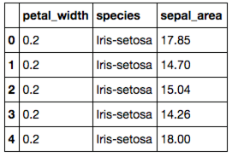
Assigning New Data to a DataFrame
Data can be (re)assigned to a DataFrame column
CODE
# Create a new column that is a product
# of both measurements
data['sepal_area'] = data.sepal_length
*data.sepal_width
# Print a few rows and columns
print(data.iloc[:5, -3:])
OUTPUT
>>>

Slide 68
Applying a Function to a DataFrame Column
Functions can be applied to columns or rows of a DataFrame or Series
CODE
# The lambda function applies what
# follows it to each row of data
data['abbrev'] = (data
.species
.apply(lambda x: x.replace('Iris-','')))
# Note that there are other ways to
# accomplish the above
print(data.iloc[:5, -3:])
OUTPUT

Slide 69
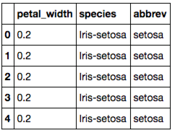
Applying a Function to a DataFrame Column
Functions can be applied to columns or rows of a DataFrame or Series
CODE OUTPUT
# The lambda function applies what
# follows it to each row of data
data['abbrev'] = (data
.species
.apply(lambda x: x.replace('Iris-','')))
>>>
# Note that there are other ways to
# accomplish the above
print(data.iloc[:5, -3:])

Slide 70
Concatenating Two DataFrames
Two DataFrames can be concatenated along either dimension
CODE
# Concatenate the first two and
# last two rows
small_data = pd.concat([data.iloc[:2],
data.iloc[-2:]])
print(small_data.iloc[:,-3:])
# See the 'join' method for
# SQL style joining of dataframes
OUTPUT

Slide 71
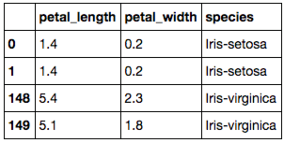
Concatenating Two DataFrames
Two DataFrames can be concatenated along either dimension
CODE
# Concatenate the first two and
# last two rows
small_data = pd.concat([data.iloc[:2],
data.iloc[-2:]])
print(small_data.iloc[:,-3:])
# See the 'join' method for
# SQL style joining of dataframes
OUTPUT
>>>

Slide 72
Aggregated Statistics with GroupBy
Using the groupby method calculated aggregated DataFrame statistics
CODE
OUTPUT
# Use the size method with a
# DataFrame to get count
# For a Series, use the .value_counts
# method
group_sizes = (data
.groupby('species’)
.size())
print(group_sizes)

Slide 73
Aggregated Statistics with GroupBy
Using the groupby method calculated aggregated DataFrame statistics
CODE
OUTPUT
# Use the size method with a
# DataFrame to get count
# For a Series, use the .value_counts
# method
group_sizes = (data
.groupby('species’)
.size())
print(group_sizes)
>>> species
Iris-setosa Iris-versicolor Iris-virginica dtype: int64
50
50
50

Slide 74
Performing Statistical Calculations
Pandas contains a variety of statistical methods—mean, median, and mode
CODE
OUTPUT
# Mean calculated on a DataFrame
print(data.mean())

Slide 75
Performing Statistical Calculations
Pandas contains a variety of statistical methods—mean, median, and mode
CODE
OUTPUT
# Mean calculated on a DataFrame
print(data.mean())
>>> sepal_length 5.843333
sepal_width 3.054000
petal_length 3.758667
petal_width 1.198667 dtype: float64

Slide 76
Performing Statistical Calculations
Pandas contains a variety of statistical methods—mean, median, and mode
CODE
OUTPUT
>>> sepal_length 5.843333
sepal_width 3.054000
petal_length 3.758667
petal_width 1.198667 dtype: float64
>>> 4.35
# Mean calculated on a DataFrame
print(data.mean())
# Median calculated on a Series
print(data.petal_length.median())

Slide 77
Performing Statistical Calculations
Pandas contains a variety of statistical methods—mean, median, and mode
CODE OUTPUT
# Mean calculated on a DataFrame
print(data.mean())
>>> sepal_length 5.843333
sepal_width 3.054000
petal_length 3.758667
petal_width 1.198667 dtype: float64
>>> 4.35
# Median calculated on a Series
print(data.petal_length.median())
# Mode calculated on a Series
print(data.petal_length.mode())
>>> 0 1.5
dtype: float64

Slide 78
Performing Statistical Calculations
Standard deviation, variance, SEM, and quantiles can also be calculated
CODE
OUTPUT
# Standard dev, variance, and SEM
print(data.petal_length.std(), data.petal_length.var(), data.petal_length.sem())

Slide 79
Performing Statistical Calculations
Standard deviation, variance, SEM, and quantiles can also be calculated
CODE
OUTPUT
# Standard dev, variance, and SEM
print(data.petal_length.std(), data.petal_length.var(), data.petal_length.sem())
>>> 1.76442041995
3.11317941834
0.144064324021

Slide 80
Performing Statistical Calculations
Standard deviation, variance, SEM, and quantiles can also be calculated
CODE
OUTPUT
>>> | 1.76442041995
 | 3.11317941834
 | 0.144064324021
>>> | sepal_length 4.3
 | sepal_width 2.0
 | petal_length 1.0
 | petal_width 0.1
 | Name: 0, dtype: float64
# Standard dev, variance, and SEM
print(data.petal_length.std(), data.petal_length.var(), data.petal_length.sem())
# As well as quantiles
print(data.quantile(0))

Slide 81
Performing Statistical Calculations
Multiple calculations can be presented in a DataFrame
CODE
OUTPUT
print(data.describe())

Slide 82
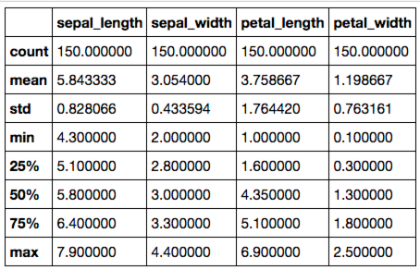
Performing Statistical Calculations
Multiple calculations can be presented in a DataFrame
CODE
OUTPUT
print(data.describe())
>>>

Slide 83
Sampling from DataFrames
DataFrames can be randomly sampled from
CODE
OUTPUT
# Sample 5 rows without replacement
sample = (data
.sample(n=5,
replace=False, random_state=42))
print(sample.iloc[:,-3:])

Slide 84
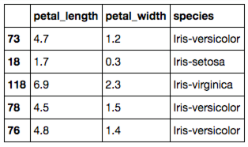
Sampling from DataFrames
DataFrames can be randomly sampled from
CODE
OUTPUT
# Sample 5 rows without replacement
sample = (data
.sample(n=5,
replace=False, random_state=42))
print(sample.iloc[:,-3:])
>>>

Slide 85
Sampling from DataFrames
DataFrames can be randomly sampled from
CODE
OUTPUT
# Sample 5 rows without replacement
sample = (data
.sample(n=5,
replace=False, random_state=42))
>>>
print(sample.iloc[:,-3:])
SciPy and NumPy also contain a variety of statistical functions.

Slide 86
Visualization Libraries

Slide 87
Visualization Libraries
Visualizations can be created in multiple ways:
Matplotlib
Pandas (via Matplotlib)
Seaborn
Statistically-focused plotting methods
Global preferences incorporated by Matplotlib
100

Slide 88
Basic Scatter Plots with Matplotlib
Scatter plots can be created from Pandas Series
CODE
OUTPUT
Import matplotlib.pyplot as plt
plt.plot(data.sepal_length,
data.sepal_width, ls ='', marker='o')
100

Slide 89

Basic Scatter Plots with Matplotlib
Scatter plots can be created from Pandas Series
CODE
OUTPUT
Import matplotlib.pyplot as plt
4.5
plt.plot(data.sepal_length,
data.sepal_width, ls ='', marker='o')
4.0
3.5
3.0
2.5
2.0
5
6
7
8
100

Slide 90
Basic Scatter Plots with Matplotlib
Multiple layers of data can also be added
CODE
plt.plot(data.sepal_length,
data.sepal_width, ls ='', marker='o’, label='sepal')
plt.plot(data.petal_length,
data.petal_width, ls ='', marker='o’, label='petal')
OUTPUT
100

Slide 91
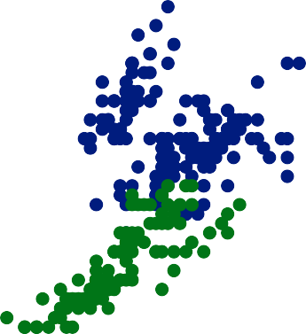

Basic Scatter Plots with Matplotlib
Multiple layers of data can also be added
CODE
plt.plot(data.sepal_length,
data.sepal_width, ls ='', marker='o’, label='sepal')
plt.plot(data.petal_length,
data.petal_width, ls ='', marker='o’, label='petal')
OUTPUT
sepal petal
4
3
2
1
0
2 4 6 8
100

Slide 92
Histograms with Matplotlib
Histograms can be created from Pandas Series
CODE
OUTPUT
plt.hist(data.sepal_length, bins=25)
100

Slide 93
Histograms with Matplotlib
Histograms can be created from Pandas Series
CODE
OUTPUT
plt.hist(data.sepal_length, bins=25)
16
14
12
10
8
6
4
2
0
5
6
7
8
100

Slide 94
Customizing Matplotlib Plots
Every feature of Matplotlib plots can be customized
CODE
fig, ax = plt.subplots() ax.barh(np.arange(10),
data.sepal_width.iloc[:10])
# Set position of ticks and tick labels ax.set_yticks(np.arange(0.4,10.4,1.0)) ax.set_yticklabels(np.arange(1,11)) ax.set(xlabel='xlabel', ylabel='ylabel’,
title='Title')
OUTPUT
100

Slide 95
Customizing Matplotlib Plots
Every feature of Matplotlib plots can be customized
CODE
fig, ax = plt.subplots() ax.barh(np.arange(10),
data.sepal_width.iloc[:10])
# Set position of ticks and tick labels ax.set_yticks(np.arange(0.4,10.4,1.0)) ax.set_yticklabels(np.arange(1,11)) ax.set(xlabel='xlabel', ylabel='ylabel’,
title='Title')
OUTPUT
100

Slide 96
Incorporating Statistical Calculations
Statistical calculations can be included with Pandas methods
CODE
OUTPUT
(data
.groupby('species')
.mean()
.plot(color=['red','blue’,
'black','green’], fontsize=10.0, figsize=(4,4)))
100

Slide 97
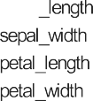
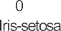
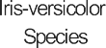
Incorporating Statistical Calculations
Statistical calculations can be included with Pandas methods
CODE
OUTPUT
(data
.groupby('species')
.mean()
.plot(color=['red','blue’,
'black','green’], fontsize=10.0, figsize=(4,4)))
100

Slide 98
Statistical Plotting with Seaborn
Joint distribution and scatter plots can be created
CODE
OUTPUT
import seaborn as sns
sns.jointplot(x='sepal_length’,
y='sepal_width’, data=data, size=4)
100

Slide 99

Statistical Plotting with Seaborn
Joint distribution and scatter plots can be created
CODE
OUTPUT
import seaborn as sns
sns.jointplot(x='sepal_length’,
y='sepal_width’, data=data, size=4)
4.5
pearsonr
-0.11; p
0.18
4.0
sepal_width
3.5
3.0
2.5
2.0
5
6
sepal_length
7
8
100

Slide 100
Statistical Plotting with Seaborn
Correlation plots of all variable pairs can also be made with Seaborn
CODE
OUTPUT
sns.pairplot(data, hue='species', size=3)
100

Slide 101



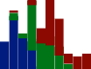

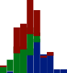





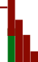



Statistical Plotting with Seaborn
Correlation plots of all variable pairs can also be made with Seaborn
CODE
OUTPUT
sns.pairplot(data, hue='species', size=3)
8
sepal_length
6
sepal_width
4
3
2
species
Iris-setosa Iris-versicolor Iris-virginica
petal_length
6
4
2
petal_width
2
1
0
5.0
sepal_length
7.5
2
4
2.5 5.0
petal_length
0
2
petal_width
sepal_width
100

Slide 102


